Slide 1

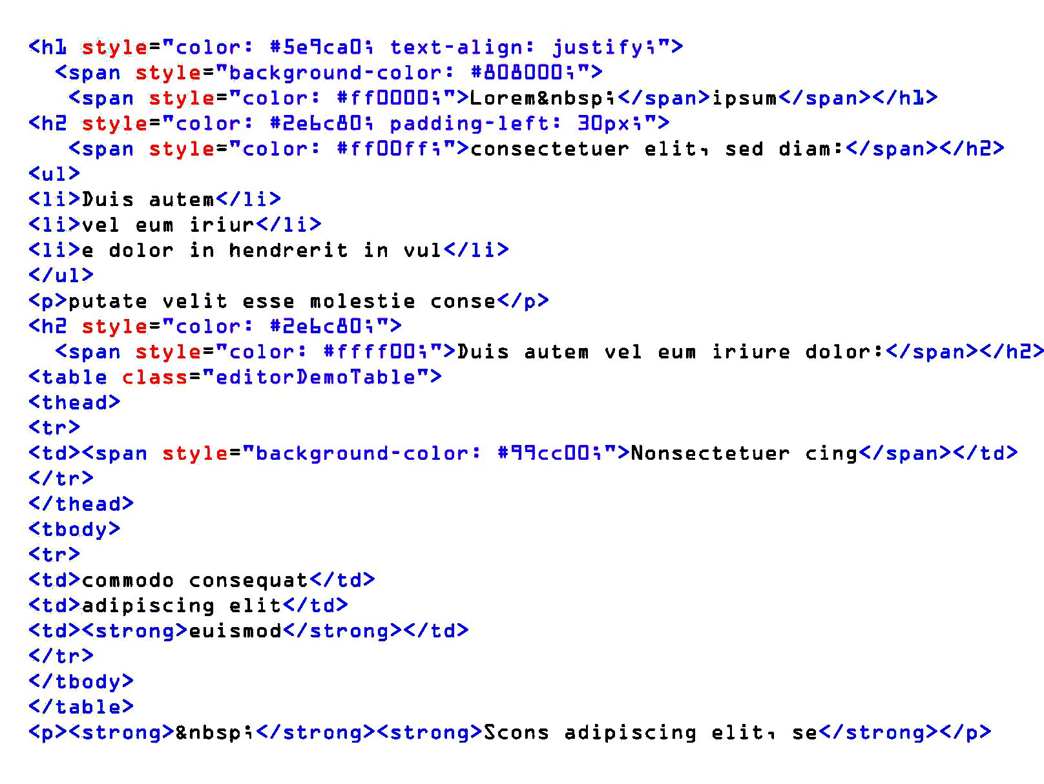
WE ARE HIRING
FULL STACK DEVELOPER
Degree: bachelor, master
Required Skills: SQL , Go, HTML5, CSS,
Vue.js, Javascript, Node.js, Java, Python,
MariaDB, MongoDB, ASP.NET, C# , Git
Salary: $49561/year
Working hours : Day shift, 08:30~18:00
Compensation: Year-end bonus, overtime pay
Benefits: Offer Meal, Two-day weekend, Annual leave,
Paid leave
Location:19 14th Avenue San Francisco,ca, 94118 United States
Tel:+1-1605673834
Email:Xtech@gmail.com

